Slide 1
Database Design & Applications
(SS ZG 518)
Dr.R.Gururaj
CS&IS Dept.

Slide 2
Lecture Session-2
DBMS Concepts and Users (Ch. 1 & 2)
    Content
    Database Systems
    DBMS
    Database System environment
    Traditional file systems for storing data
    Advantages of DBMS over traditional file systems
    Describing and Storing data in DBMS
    Three schema Architecture
    Data independence
    Structure of a DBMS
    People who work with DBMS
1 28/07/2014 Dr.R.Gururaj SSZG 518 Database Design & Applications

Slide 3
Introduction
Databases and Systems to manage them have become significant components of any present day business of any nature. It has a major impact on growing use of computers.
These databases help businesses to perform their day-to-day activities in an efficient and effective manner.
Ex: Banking; Travel ticket reservation; Library catalog search
Advances in technology have given raise to new concepts-
Like- Multimedia Databases; Data Integration; Big data; GIS; Web Data; Data Warehousing; Data Mining etc.
2 28/07/2014 Dr.R.Gururaj SSZG 518 Database Design & Applications

Slide 4
Data: Known fact that can be recorded and that has implicit meaning.
Ex. Name, Tel_no, city etc.
This data can be stored in a file on a computer.
Database: Is a collection of related data.
It is a collection of logically related data.
A database is designed, built and populated with data for a specific purpose.
3 28/07/2014 Dr.R.Gururaj SSZG 518 Database Design & Applications

Slide 5
DBMS
DBMS: Is a collection of programs that enables users to create and maintain databases in a convenient and effective manner.
DBMS is a software system that facilitates the following:
1.Defining the database: This includes defining the structures, data types, constraints, indexes etc.
Database catalog/Data dictionary/ called as Meta-data
2.Constructing the database: This means storing data into the database structures and storing on some storage medium.
3.Manipulating database for various applications: This encompasses activities like – querying the database, inserting new records into the database, updating some data items, and deleting certain items from the database.
What is DBMS?
What is a Database System?
4 28/07/2014 Dr.R.Gururaj SSZG 518 Database Design & Applications

Slide 6

5 28/07/2014 Dr.R.Gururaj SSZG 518 Database Design & Applications

Slide 7
Traditional file systems for storing the data
If we take the example of savings bank enterprise, information about customers and savings accounts etc. need to be stored.
One way to keep the information on computers is to store in files provided by operating systems (OS).
Disadvantages of the above System
Difficulty in accessing data (possible operations need to be hard- coded in programs).
Redundancy leading to inconsistency.
Inconsistent changes made by concurrent users.
No recovery on crash.
The security provided by OS in the form of password is not sufficient.
Data Integrity is not maintained.
6 28/07/2014 Dr.R.Gururaj SSZG 518 Database Design & Applications

Slide 8
Advantages of using DBMS
Data independence
Efficient data access
Data integrity and security
Data Administration
Concurrent access and Crash recovery
Reduced application development time
7 28/07/2014 Dr.R.Gururaj SSZG 518 Database Design & Applications

Slide 9
Disadvantages of DBMS
Extra cost due to SW, HW and training.
Not suitable or effective for certain applications (Real-time constraints; well-defined limited operations)
Data manipulation not supported by Query languages.
8 28/07/2014 Dr.R.Gururaj SSZG 518 Database Design & Applications

Slide 10
Describing and storing data in DBMS
Data Model
Is a collection of concepts that can be used to describe the structure of the database.
Structure means data types, relationships, constraints etc.
DBMS allows a user to define the data to be stored in terms of a data model.
i) high-level data models (ii) low-level data models, (iii) representational or implementation data models
High-level Data Models: Use set of concepts to describe the database, where the descriptions are close to user views. High-level data models are also known as conceptual models.
In conceptual data modeling we use concepts like – entity, attributes, relationship etc.
Low-level Data Models: give details about how the data is stored in a computers (storage level details).
9 28/07/2014 Dr.R.Gururaj SSZG 518 Database Design & Applications

Slide 11
Representational/Implementation Data Models:
This is in between high-level and low-level data models.
Here we represent the concepts described in conceptual model using a specific structures like, networks, objects, tables, trees etc.
Ex: Relational Model, NW Model, Hierarchical Model, Object Model, Object relational model etc.
28/07/2014 Dr.R.Gururaj SSZG 518 Database Design & Applications

Slide 12
Relational Model:
The central data description construct in this model is a relation,
which can be thought of as a set of records.
Schema: Description of data in terms of a data model is called a schema.
A relation schema specifies the name of the relation, fields, type etc.
Ex. Student (sid: string; name: string; age: integer)
every row follows the schema of the relation.
10 28/07/2014 Dr.R.Gururaj SSZG 518 Database Design & Applications

Slide 13
The following are some important representational data models (DBMS Specific)
1. Network Model: Though the basic structure is a record,
the relationships are captured using links.
The database can be seen as an arbitrary network of records connected by links.
Ex.: GE’s Integrated Data store (IDS), in Early 1960s
2. Hierarchical Model: The records containing data are organized
as a collection of trees. Ex.: IBMs IMS (Information Management System),
in late 1960s
3. Relational Model: (early 1970s)Data & relationships are captured as tables & keys.
Ex.: Oracle, IBMs DB2, MySQL, Informix, Sybase, MS Access, Ingress, MySQL etc.
The basic storage structure is a record.
4. Object Data Model: Objects created through object–oriented programs
can be stored in database.
Ex.: Object Store
5. Object Relational Model: Objects can be stores in tables.
Ex.: Oracle, Informix
11 28/07/2014 Dr.R.Gururaj SSZG 518 Database Design & Applications

Slide 14
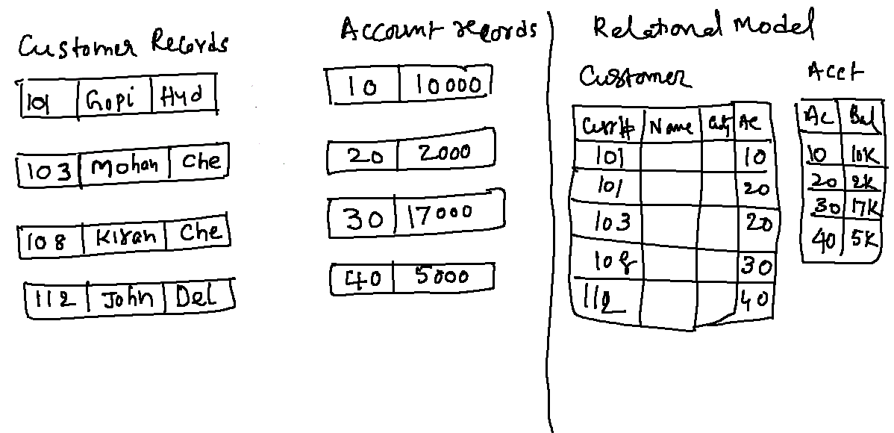

Slide 15
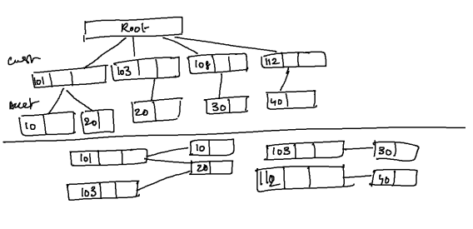
Hierarchical Model:
Network Model

Slide 16
Database Schema
Database Schema: Description of a database is called as database Schema
Three-Schema Architecture
A database can be described using three different levels of abstractions.
Description at each level can be defined by a schema. For each abstraction we focus on one of the specific issues such as user views, concepts, storage etc.
External schema: Used to describe the database at external level.
Also described in terms of the data model of that DBMS. This allows data access to be customized at the level of individual users/groups/applications.
Any external schema has one or more views and relations from the conceptual schema. This schema design is guided by end user requirements.
Conceptual schema (logical schema) Describes the stored data in terms of the data model specific to that DBMS. In RDBMS conceptual schema describes all relations that are stored in the database. Arriving at good choice of relations, fields and constraints is known as conceptual database design.
3. Physical schema: Describes the physical storage strategy for the database.
12 28/07/2014 Dr.R.Gururaj SSZG 518 Database Design & Applications

Slide 17
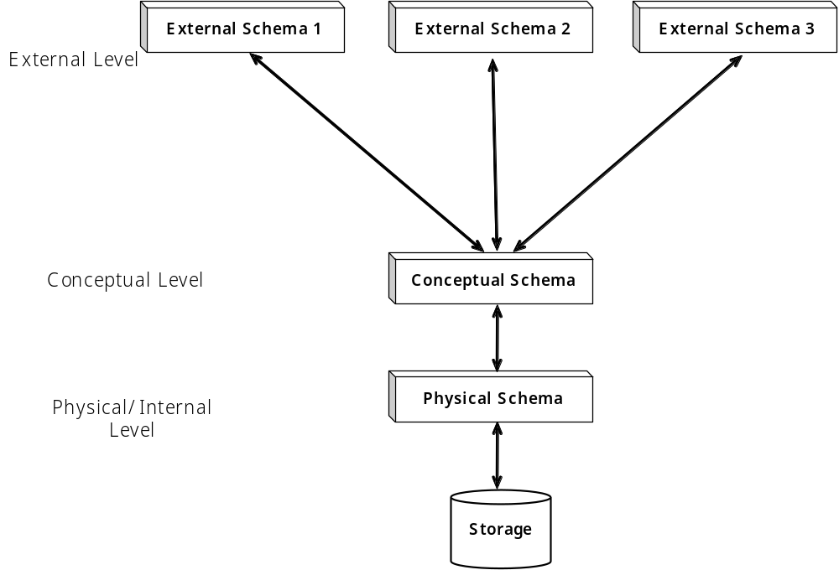
Three Schema Architecture
Three schema architecture of DBMS
13 28/07/2014 Dr.R.Gururaj SSZG 518 Database Design & Applications

Slide 19
Data Independence
Data Independence:
The three-level architecture which is the result of the three-level abstraction on database, leads to data independence.
Logical data independence: changes in conceptual level schema should not affect the application level or external level schemas.
2. Physical data independence: The changes in physical features of storage, i.e., changes to the physical storage format should not affect schema at conceptual level.
The above data independence is one of the important advantages of DBMS.
The DBMS stores the description of schemas as System catalog.
14 28/07/2014 Dr.R.Gururaj SSZG 518 Database Design & Applications

Slide 20
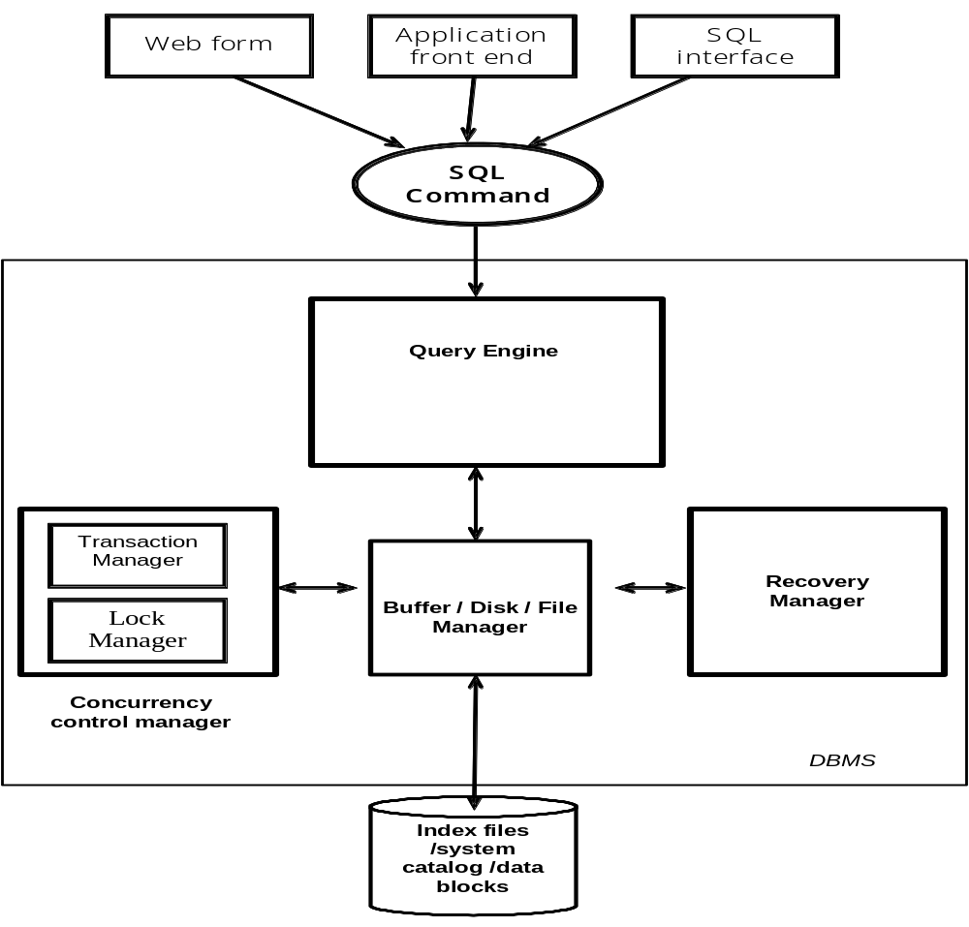
DBMS Structure
15 28/07/2014 Dr.R.Gururaj SSZG 518 Database Design & Applications

Slide 21
People who work for/with DBMS
    Database administrator (DBA)
    Database Designers
    End users
    Application Programmers
    DBMS developers/ Tool developers
    Operators & maintenance team
    DBA’s role:
    1. Design of physical & Conceptual schemas
    2. Security and authorization
    3. Data availability , recovery and backup
4. Database tuning- modifying the schemas to meet the requirements
16 28/07/2014 Dr.R.Gururaj SSZG 518 Database Design & Applications

Slide 22
    Summary
    What is Data, Database, and DBMS
    Importance of DBMS
    Storing data in Traditional file systems
    Advantages of DBMS over traditional file systems
    How data is described in a DBMS
    What is a data model
    What is a schema
    What is three schema architecture of a DBMS
    What is data independence
    Transaction management
    Components of a DBMS
    People working on DBMS
17 28/07/2014 Dr.R.Gururaj SSZG 518 Database Design & Applications

Slide 23
Conceptual Database Design (ER Modeling) Ch. 3 & 4
    Content
    ER Model
    Steps in Database Design Process
    Entities, Attributes, and Associations
    ER Notations
    Enhanced ER modeling
    Super-class and sub-class representation
18 28/07/2014 Dr.R.Gururaj SSZG 518 Database Design & Applications

Slide 24
Major Steps in Database Design Process
  Step 1: Requirement analysis
    Understanding the domain
    Identifying the data to be stored
    Identifying the constraints
  Step 2: Conceptual Database design
  (Semantic Conceptual Schema)
E-R modeling/UML
  Step 3: Logical Database Design
Designing tables and relationships
  Step 4: Refinement of schema
  Step 5: Physical database design
    Indexing
    Clustering
    Storage formats
19 28/07/2014 Dr.R.Gururaj SSZG 518 Database Design & Applications

Slide 25
ER Modeling
ER Model is a popular high-level (conceptual) data model.
It is an approach to designing Semantic Conceptual schema of a Database.
ER model allows us to describe the data involved in a real-world environment in terms of objects and their relationships, which are widely used in design of database.
ER model provides preliminary concepts or idea about the data representation which is later modified to achieve final detailed design.
20 28/07/2014 Dr.R.Gururaj SSZG 518 Database Design & Applications

Slide 26
ER Modeling
Important concepts/notions used in ER modeling are-
Entity is an object in real-world or some idea or concept which can be distinguished from other objects.
Ex.: person, school, class, department, weather, salary, temperature etc.
Entity has independent existence.
Each entity belongs to an Entity type that defines the structure.
Entity Set is a Collection of similar objects.
21 28/07/2014 Dr.R.Gururaj SSZG 518 Database Design & Applications

Slide 27

28/07/2014 Dr.R.Gururaj SSZG 518 Database Design & Applications

